Slide 1
Team Building and Teamwork
Rachel Clayberg
Nichole Lynch

Slide 2
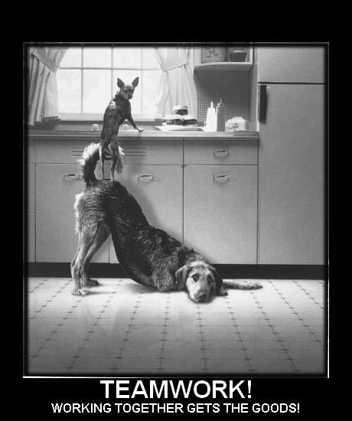

Slide 3
What is a Team?
Any group of people organized to work together or interdependently in order to cooperatively meet the needs of their customers by accomplishing a purpose or goal.
  Together
  Everyone
  Accomplishes
  More
Notes:
Rachel
Book definition: A group of people with a common, collective goal. Everyone in the team must be aware of the goal and must work with other members of the team to achieve that goal.

Slide 4
Need for a Team
Why do companies use teams?
  Satisfies the human social need to belong
  Two heads are better than one
  The whole can be greater than the sum of its parts
  Team members build trust and want to help each other
  Promotes better communication
  Multiplies the potential of individual members
  Produces positive peer pressure
Notes:
Rachel
Teams are able to outperform individuals. In the context of Total Quality Management, teams are said to facilitate information sharing, problem solving, and to develop employee responsibility for managing quality performance.
Team working is also seen to promote communication between employees and management, which in turn facilitates the integration of the organizational quality mission.
Promotes communication and cooperation between employees in different areas of the organization, which facilitates problem solving.

Slide 5
Purpose of a Team
Provides a framework that will increase the ability of employees to participate in planning, problem solving, and decision making.
Notes:
Rachel
Better understanding of decisions
More support for and participation in implementation of plans
Increased contribution to problem solving and decision making
More ownership of decision, processes, and changes

Slide 6
Forming a Team
Makeup
  Should be composed of people who are most likely going to be able to satisfy the team’s mission effectively.
  Commitment to the team and its purpose.
  Diversity of skills and personalities.
Notes:
Rachel
All team efforts should be directed towards the same clear goals. This will rely heavily on communication throughout the team and relationships between team members.
Team members should be able to utilize their strengths and be able to compensate for other weaknesses that are present within the team.
Different personality types should be balanced and be able to compensate for each other.

Slide 7
Character Traits & Teamwork
What are some traits that can contribute to the success of a team?
  Honesty/integrity Initiative
  Selflessness Patience
  Dependability Resourcefulness
  Enthusiasm Punctuality
  Responsibility Tolerance/sensitivity
  Cooperativeness Perseverance
Notes:
Rachel
Facilitate Open Questions

Slide 8
Forming a Team
Roles and Responsibilities
  Team Leader
  Team Recorder
  Team Quality Advisor
  Team Member
Notes:
Rachel
*Slide co-insides with activity: students should select role cards and find out their role within the company activity

Slide 9
Forming a Team
Team Leader
  Official contact between the team and the rest of the organization
  Official record keeper
  Serve as a team member
  Implement team recommendation
  Will be the “coach” for the rest of the team
Notes:
Rachel

Slide 10
Forming a Team
Coaching
  Team leaders should facilitate team development and continuous improvement
    Give teams a clearly defined charter
    Make team development and team building constant activities
    Mentor team members
    Promote mutual respect between themselves and team members
    Positively promote diversity within the team
    Employee empowerment
Notes:
Rachel
Coaches or team leaders should be specific in explaining the team’s mission and purpose to members of their team.
Developing skills and building the team should be an ongoing process that is continually updated and perfected.
Coaches should establish a caring nurturing relationship with team members. They should assist in developing the capabilities of team members, improving the contribution of individuals to the team, and help team members in advancing their careers.
It is important for team members and team leaders to develop a mutual respect for each other. This is accomplished through trust, communication, and making team members feel like they are assets to the entire team and the organization. Team member must also develop this same respect with other members of the team.
Promoting diversity can help to bring new ideas and varying perspectives that can assist the organization in gaining an advantage over competitors.
Employees and team members that are physically, intellectually, and emotionally involved in their work will feel a stronger sense of ownership. They will feel more important to the company and feel like their input is really making a difference in the success of the group or of the company as a whole. This will result in better performance and higher levels of productivity.

Slide 11
Forming a Team
Team Recorder
  Takes minutes during team meetings
  Assists the team leader with other types of correspondence that is generated by the team
Notes:
Rachel

Slide 12
Forming a Team
Team Quality Advisor
  Focuses on team processes and how decisions are made
  Assists the team leader in breaking down tasks into component parts and assigning those parts to other team members
  Helps the team leader prepare for meetings
  Helps the team members learn to use the scientific approach
  Helps team members convert their recommendations into presentations that can be made to upper management
Notes:
Rachel

Slide 13
Forming a Team
Team Charter
  Team Mission
  Ground Rules
  Team Goals
Notes:
Nichole
*This slide co-insides with the activity: explain creation of mission statement and have each company create their mission statement. Express some ground rules and team goals.

Slide 14
Forming a Team
Mission Statement
  Broad, encompasses all activities, progress can be measured and SIMPLICITY
  Ex. The purpose of this team is to reduce the time between when an order is taken and when it is filled, while simultaneously improving the quality of products shipped.
Notes:
Goes along with activity: Mission Statement: things to keep in mind are broadness, appropriate specificity and simplicity

Slide 15
Forming a Team
Ground Rules
  Agreed upon by the whole team
  Describes agreed upon actions and characteristics of team members
Notes:
Characteristics include: honesty, trust, dependability, mutual support, responsibility, cooperation, patience, resourcefulness, punctuality, tolerance of and sensitivity to cultural differences, perseverance, conflict management.

Slide 16
Forming a Team
Goals: reaching the mission
  Ad Hoc Teams
  Permanent Teams
Notes:
Ad Hoc teams: temporary, goals are a part of charter
Permanent Teams: not included because they are ever evolving

Slide 17
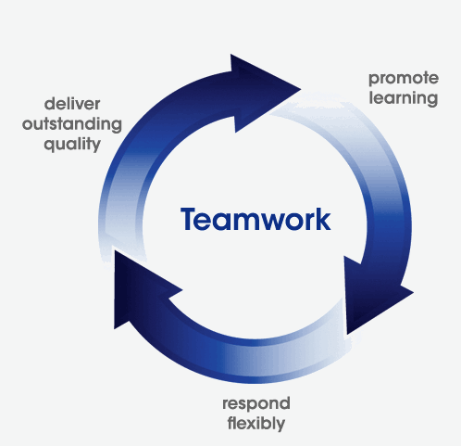
Teamwork Cycle
Notes:
Nichole
Salford City College in the UK apart of their mission interesting relates to quality service
By promoting learning to staff, respond to internal and external customers flexibly Continue to seek outstanding quality through servie

Slide 18
Team Building
Four-Step Approach
  Assess
  Plan
  Execute
  Evaluate
Notes:
Nichole

Slide 19
Team Building-Assess
Look for strengths and weaknesses in team members
For a team to be successful, the following characteristics are needed:
  A clear direction that is understood by all team members
  Team players
  Understood and accepted accountability measures
Notes:
Nichole
Needs Assessment could be completed

Slide 20
Team Building-Plan
Planning
  Based on the results of a needs assessment
  Activities should be based on the strengths and weaknesses of the needs assessment
Notes:
Nichole

Slide 21
Team Building-Execute
Execution
  Just-in-time
  Continuous improvement
Notes:
Nichole
Best time is after a team has been formed and given its charter apply what they learn immediately
Continue training and activities as a team grows it is an ongoing process

Slide 22
Team Building-Evaluate
Evaluation
  Effectiveness can be measured based on how well weaknesses identified in the needs assessment were strengthened.
  Re-administer the needs assessment
  Could result in additional team building activities
Notes:
Nichole
If follow up is not conducted after team building activities, people will begin to think that these types of activities are a waste of their time. Results need to be clear and a course of action should be developed in order to show team members what the next steps are and how the team building activity is going to strengthen their team.

Slide 23
Reasons for Conflict
Communication
Structure
Personal
Notes:
Nichole
Three most common reasons for conflict
Barriers to communication are among the most important factors and can be a major source of misunderstanding. Communication barriers include poor listening skills; insufficient sharing of information; differences in interpretation and perception; and nonverbal cues being ignored or missed. Structural disagreements include the size of the organization, turnover rate, levels of participation, reward systems, and levels of interdependence among employees. Personal factors include things such as an individual's self-esteem, their personal goals, values and needs

Slide 24
Conflict Resolution
Set a positive example of teamwork and resolving conflicts at a company level
Identify and address the conflict
Turn into a positive experience
  Increase employees communication and interpersonal skills
Notes:
Nichole
http://www.innovativeteambuilding.co.uk/pages/articles/conflicts.htm

Slide 25
Conflict Resolution
Resolution Strategies:
  Acknowledge that the conflict exists.
  Gain common ground.
  Seek to understand all angles.
  Attack the issue not each other.
  Develop an action plan.
Notes:
Nichole
*everyone understands mission and goals

Slide 26
Performance & Rewards
Base
Team-Based
Total
Incentive
Notes:
Rachel
Team Compensation Components
Reinforces both team and individual performance
This method rewards on individual efforts and achievement, as well as, on team-based initiatives and accomplishments.

Slide 27
Foundations for Team-Based Rewards
Basic Requirements
  The behaviors that are expected must be communicated to all those affected so they know exactly what is meant by rewardable performance.
  Both team leaders and team members must be explicit about what behaviors are expected, why they are necessary, and how they will be recognized and rewarded.
Notes:
Rachel
Difficult to implement because people are not used to a high degree of specificity in their communication.

Slide 28
Performance & Rewards
Decide what performance to measure
Identify rewards to be offered
Integrate related processes
Determine how to measure performance
Notes:
Rachel
Model for developing a team and individual compensation system

Slide 29
Performance & Rewards
Nonmonetary Rewards
  Different people respond to different incentives.
  Organization should survey employees before implementing nonmonetary incentives.
  Set up a system where the employee can select the award that appeals to them.
Notes:
Rachel
Nonmonetary rewards could include free vacation days, event tickets, gift certificates, getaway weekends, other prizes such as electronics or household products. Continuing professional education and development is also a prime motivator.

Slide 30
Recognition
One of the strongest motivators is recognition.
There are many ways to ensure that employees are recognized for their accomplishments and their contributions.
Above all, recognize and reward good performance.
Notes:
Rachel

Slide 31
Recognition Strategies
Write a letter to the employees family.
Arrange for a senior-level manager to have lunch with the employee.
Have the CEO call the employee personally to say thank you.
What are some other recognition strategies?
Notes:
Rachel

Slide 32
Teamwork Clips
http://www.youtube.com/watch?v=jF80RqLkl6E
http://www.youtube.com/watch?v=DX2ekG5kenM&NR=1
Notes:
Rachel

Slide 33
Resources
Building Blocks For Teams (N.D.). Retrieved on 02/21/2010 from http://tlt.its.psu.edu/suggestions/teams/student/conflicts.html
Cooney, R. & Sohal, A. (2004). Teamwork and Total Quality Management: A Durable Partnership. Total Quality Management, 15(8), 1131-1142.
Goetsch, D.L & Davis, S.B. (2006). Quality Management for Organizational Excellence. Columbus, Ohio: Prentice Hall.
Strokes Jr., S.L. (1995). Rewards and Recognition for Teams. Information Systems Management ,12(3), 61-66.

